Slide 1
Computer Algorithms
Dr. Ashish Seth

Slide 2
What is a Computer Algorithm?
A computer algorithm is
  a detailed step-by-step method for
  solving a problem
  by using a computer.
  Properties
  Finiteness
  Unambiguous
  Definiteness of sequence
  Input /Output defined
  Feasibility

Slide 3
Problem Solving Strategies
Divide & Conquer
Greedy Method
Branch & Bound
Backtracking
Dynamic Programming
Brute Force
Randomized

Slide 4
Problem Solving Using Computers
Problem:
Strategy:
Algorithm:
  Input:
  Output:
  Step:
Analysis:
  Time & Space:
  Optimality:
  Correctness:
Implementation:
Verification:

Slide 5
Example: Search in an unordered array
Problem:
  Let E be an array containing n entries, E[0], …, E[n-1], in no particular order.
  Find an index of a specified key K, if K is in the array;
  return –1 as the answer if K is not in the array.
Strategy:
  Compare K to each entry in turn until a match is found or the array is exhausted.
  If K is not in the array, the algorithm returns –1 as its answer.

Slide 6
Example: Sequential Search, Unordered
Algorithm (and data structure)
  Input: E, n, K, where E is an array with n entries (indexed 0, …, n-1), and K is the item sought.
  Output: Returns ans, the location of K in E
  (-1 if K is not found.)

Slide 7
Algorithm: Step (Specification)
int seqSearch(int[] E, int n, int K)
int ans, index;
ans = -1; // Assume failure.
for (index = 0; index < n; index++)
if (K == E[index])
ans = index; // Success!
break; // Done!
return ans;

Slide 8
Analysis of the Algorithm
we measure the amount of work done by an algorithm.
Basic Operation:
  Comparison of x with an array entry
Worst-Case Analysis:
  Let W(n) be a function.
  W(n) is the maximum number of basic operations performed by the algorithm on any input size n.
  For our example, clearly W(n) = n.
  The worst cases occur when K appears only in the last position in the array and when K is not in the array at all.

Slide 9
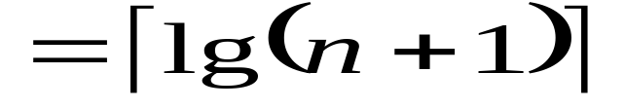
More Analysis of the Algorithm
Optimality:
  The Best possible solution?
  Searching an Ordered Array
  Using Binary Search
  W(n) = Ceiling[lg(n+1)]
  The Binary Search algorithm is optimal.

Slide 10
Correctness can be proved!
Correctness: (Proving Correctness of Procedures)
An algorithm consists of sequences of steps
(operations, instructions, statements) for transforming
inputs (preconditions) to outputs (postconditions)
Proving
  if the preconditions are satisfied,
  then the postconditions will be true,
  when the algorithm terminates.

Slide 11
Algorithm Language (Specifying the Steps)
Java/C++ as an algorithm language can be used
steps within an algorithm may be specified in pseduocode (English phrases)
Focus on the strategy and techniques of an algorithm, not on detail implementation

Slide 12
Amount of work done
  We want a measure of work that tells us something about the efficiency of the method used by the algorithm
  independent of computer, programming language, programmer, and other implementation details.
  Usually depending on the size of the input
Counting passes through loops
Basic Operation
  Identify a particular operation fundamental to the problem
  the total number of operations performed is roughly proportional to the number of basic operations
Identifying the properties of the inputs that affect the behavior of the algorithm

Slide 13
Worst-case complexity
  Let D_{n} be the set of inputs of size n for the problem under consideration, and let I be an element of D_{n}.
  Let t(I) be the number of basic operations performed by the algorithm on input I.
  We define the function W by
W(n) = max{t(I) | I ∈ D_{n}}
  called the worst-case complexity of the algorithm.
  W(n) is the maximum number of basic operations performed by the algorithm on any input of size n.
The input, I, for which an algorithm behaves worst
depends on the particular algorithm.

Slide 14
Space Usage
If memory cells used by the algorithms depends on the particular input,
  then worst-case and average-case analysis can be done.
Time and Space Tradeoff.
Normally a program require space for instructions, constants, variables used by program and input data, may also use space for manipulating data and storing information to carry out computations

Slide 15
Space Complexity contd..
Fixed part: The size required to store certain data/variables, that is independent of the size of the problem:
  - e.g. name of the data collection
  - same size for classifying 2GB or 1MB of texts
Variable part: Space needed by variables, whose size is dependent on the size of the problem:
  - e.g. actual text
  - load 2GB of text VS. load 1MB of text

Slide 16
Analysis Tool: Mathematics: Set
A set is a collection of distinct elements.The elements are of the same “type”,
“element e is a member of set S” is denoted as e ∈ S
A particular set is defined by listing or describing its elements between a pair of curly braces:
S₁ = {a, b, c}, S₂ = {x | x is an integer power of 2}
read “the set of all elements x such that x is …”
S₃ = {} = ∅, has not elements, called empty set
A set has no inherent order.

Slide 17
Subset, Superset; Intersection, Union
If all elements of one set, S₁
  are also in another set, S₂,
Then S₁ is said to be a subset of S₂, S₁ ⊆ S₂
  and S₂ is said to be a superset of S₁, S₂ ⊇ S₁.
Empty set is a subset of every set, ∅ ⊆ S
Intersection
S ∩ T = {x | x ∈ S and x ∈ T}
Union
S ∪ T = {x | x ∈ S or x ∈ T}

Slide 18
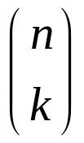
Cardinality
Cardinality
  A set, S, is finite if there is an integer n such that the elements of S can be placed in a one-to-one correspondence with {1, 2, 3, …, n}
  in this case we write |S| = n
How many distinct subsets does a finite set on n elements have? There are 2^{n} subsets.
How many distinct subsets of cardinality k does a finite set of n elements have?
There are C(n, k) = n!/((n-k)!k!), “n choose k”

Slide 19
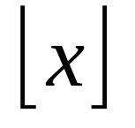
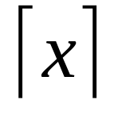
Analysis Tool: Algebra
Manipulating Inequalities
Transitivity: If ((A ≤ B) and (B ≤ C) Then (A ≤ C)
Addition: If ((A ≤ B) and (C ≤ D) Then (A+C ≤ B+D)
Positive Scaling:
If ((A ≤ B) and (α > 0) Then (α A ≤ α B)
Floor and Ceiling Functions
Floor[x] is the largest integer less than or equal to x.
Ceiling[x] is the smallest integer greater than or equal to x.

Slide 20
Logarithms
  For b>1 and x>0, log_{b}x = L such that b^{L} = x
  log_{b} is a strictly increasing function,
  if x > y then log_{b} x > log_{b} y
  log_{b} is a one-to-one function,
  if log_{b} x = log_{b} y then x = y
  log_{b} 1 = 0; log_{b} b = 1; log_{b} xª = a log_{b} x
  log_{b}(xy) = log_{b} x + log_{b} y
  x^{log y} = y^{log x}
  ^{change base:} log_{c}x = (log_{b} x)/(log_{b} c)

Slide 21
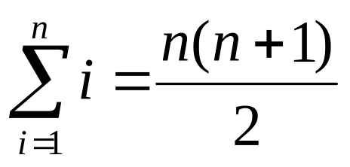
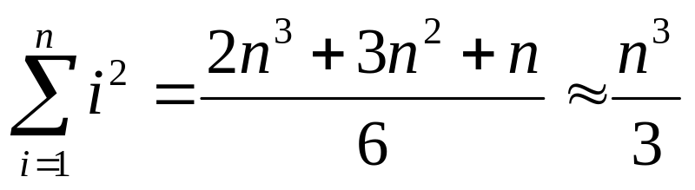
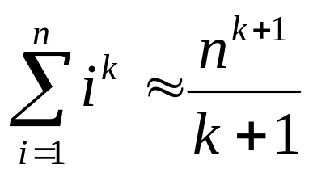
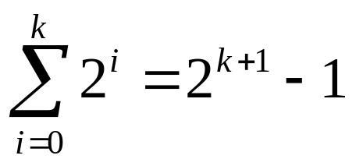
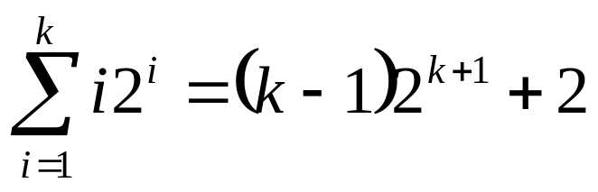
Series
A series is the sum of a sequence.
Arithmetic series
  The sum of consecutive integers
Polynomial Series
  The sum of squares
  The general case is
Power of 2
Arithmetic-
Geometric Series

Slide 22
Optimality “the best possible”
Each problem has inherent complexity
  There is some minimum amount of work required to solve it.
To analyze the complexity of a problem,
  we choose a class of algorithms (by specifying the types of operations the algorithm is permitted to perform), and
  Measure of complexity (ex, the basic operations to be counted)
  An algorithm is optimal if there is no algorithm in the class under study that performs fewer operations (in worst case)
  Optimal doesn't mean “best known ” but it means “best possible”

Slide 23
Show whether an algorithm is optimal?
Analyze the algorithm, call it A, and found the Worst-case complexity W_{A}(n), for input of size n.
Prove a theorem starting that,
  for any algorithm in the same class of A
  for any input of size n, there is some input for which the algorithm must perform at least W_{[A]}(n)
  (lower bound in the worst-case)
If W_{A}(n) == W_{[A]}(n)
  then the algorithm A is optimal
  else there may be a better algorithm
  OR there may be a better lower bound.

Slide 24
Optimality e.g.
Problem
  Fining the largest entry in an (unsorted) array of
  n numbers
Algorithm A
  int findMax(int[] E, int n)
  1. int max;
  2. max = E[0]; // Assume the first is max.
  3. for (index = 1; index < n; index++)
  4. if (max < E[index])
  5. max = E[index];
  6. return max;

Slide 25
Analyze the algorithm, find W_{A}(n)
Basic Operation
  Comparison of an array entry with another array entry or a stored variable.
Worst-Case Analysis
  For any input of size n, there are exactly n-1 basic operations
  W_{A}(n) = n-1

